Slide 1

Submitted By :-
Rohan Nair –PA02
Dhairya Hindoriya –PA03
Jash Bhowmick –PA08
Prajwal Mandawgane –PA14
Submitted To- Miss Uma Pujari

Slide 2


Slide 3


Slide 4


Slide 5


Slide 6
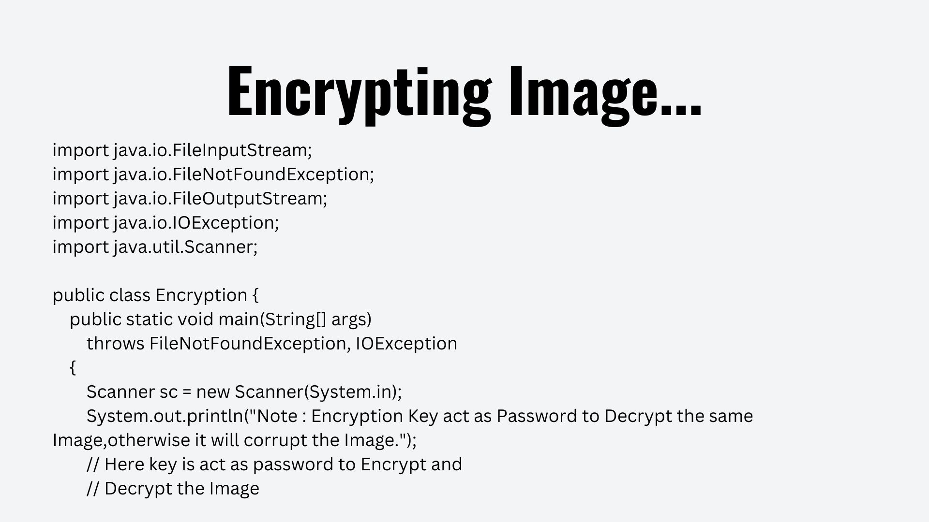

Slide 7
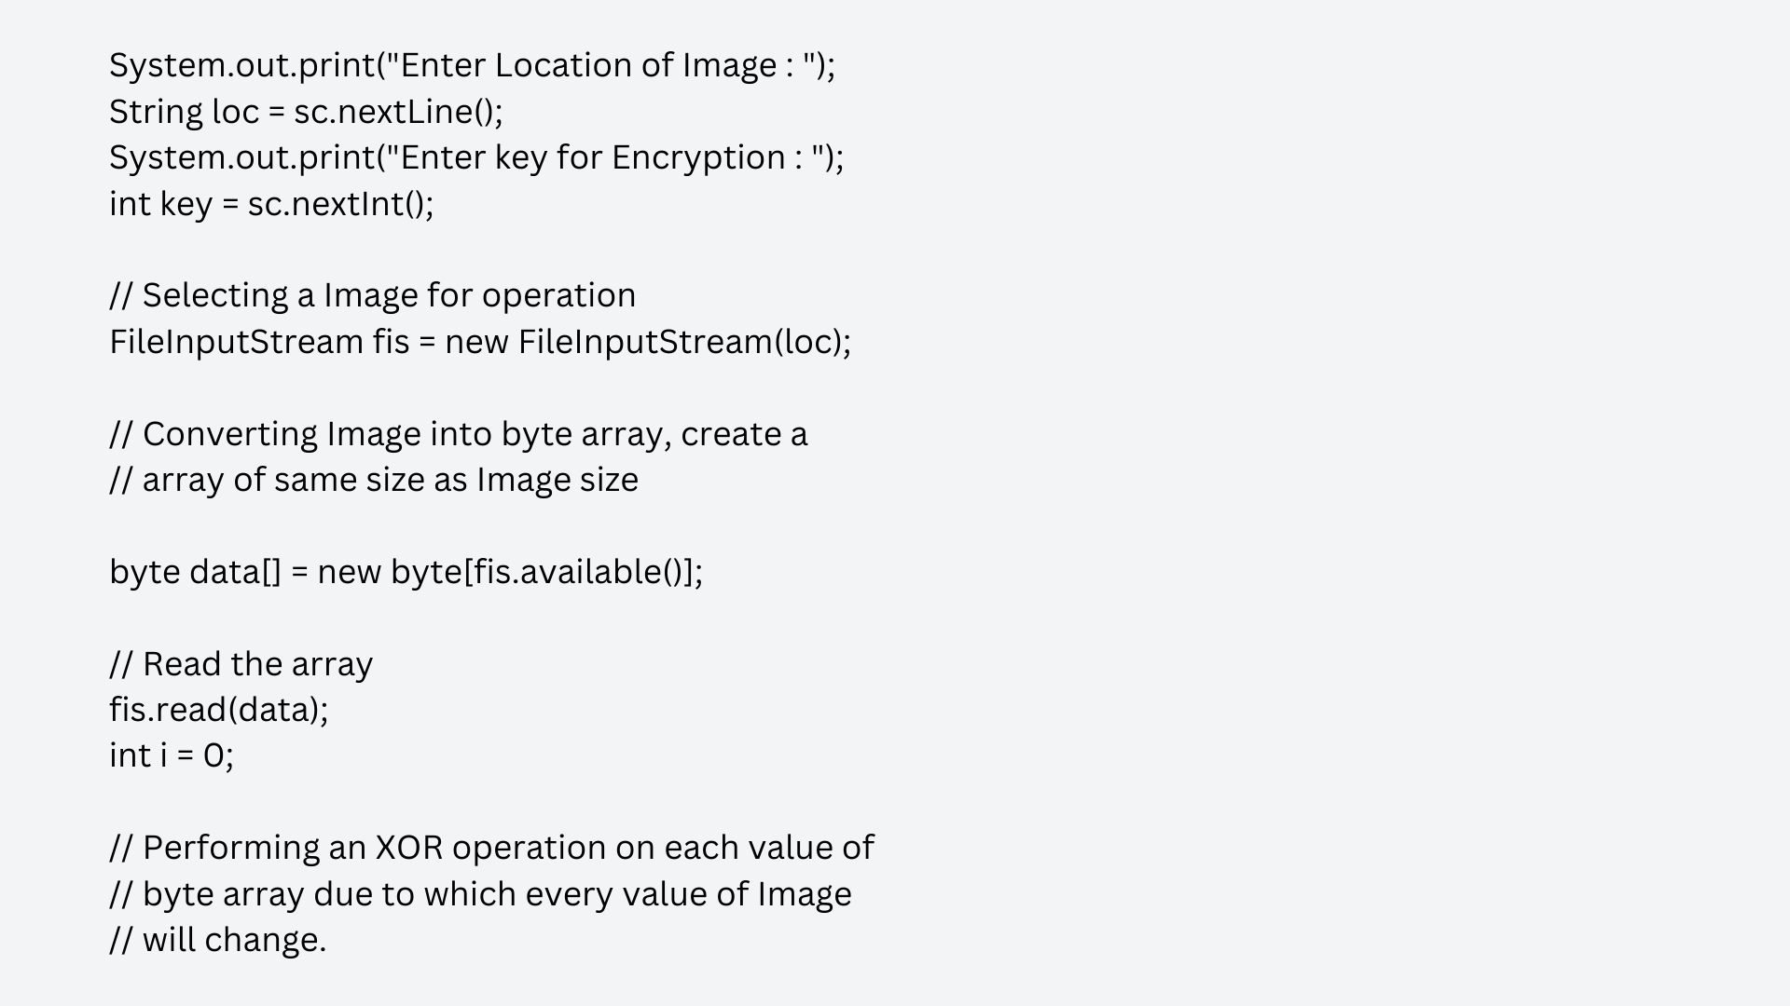

Slide 8
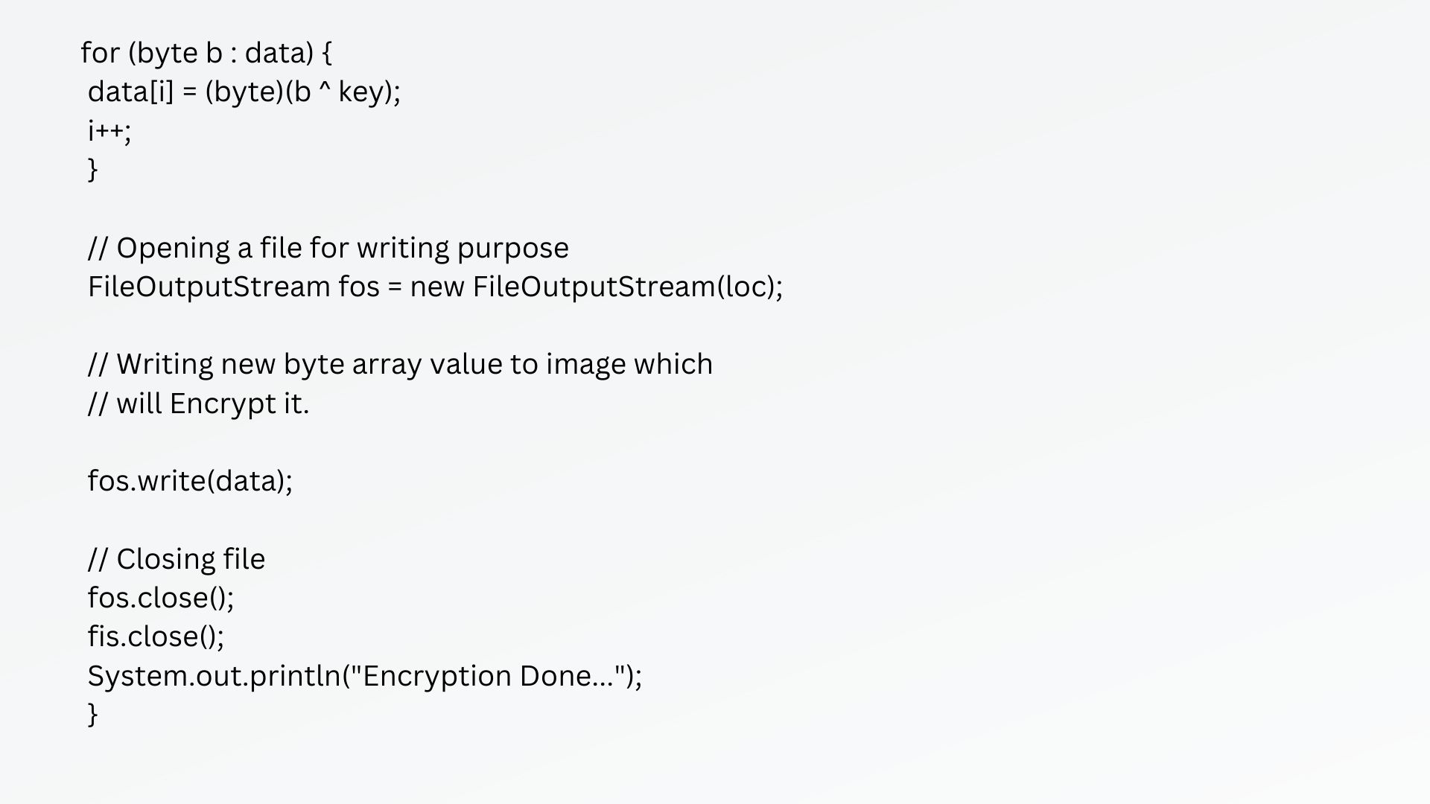

Slide 9
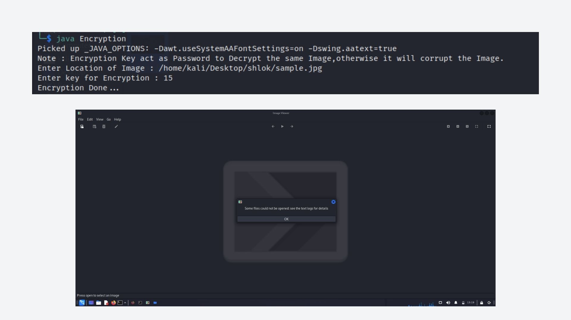

Slide 10
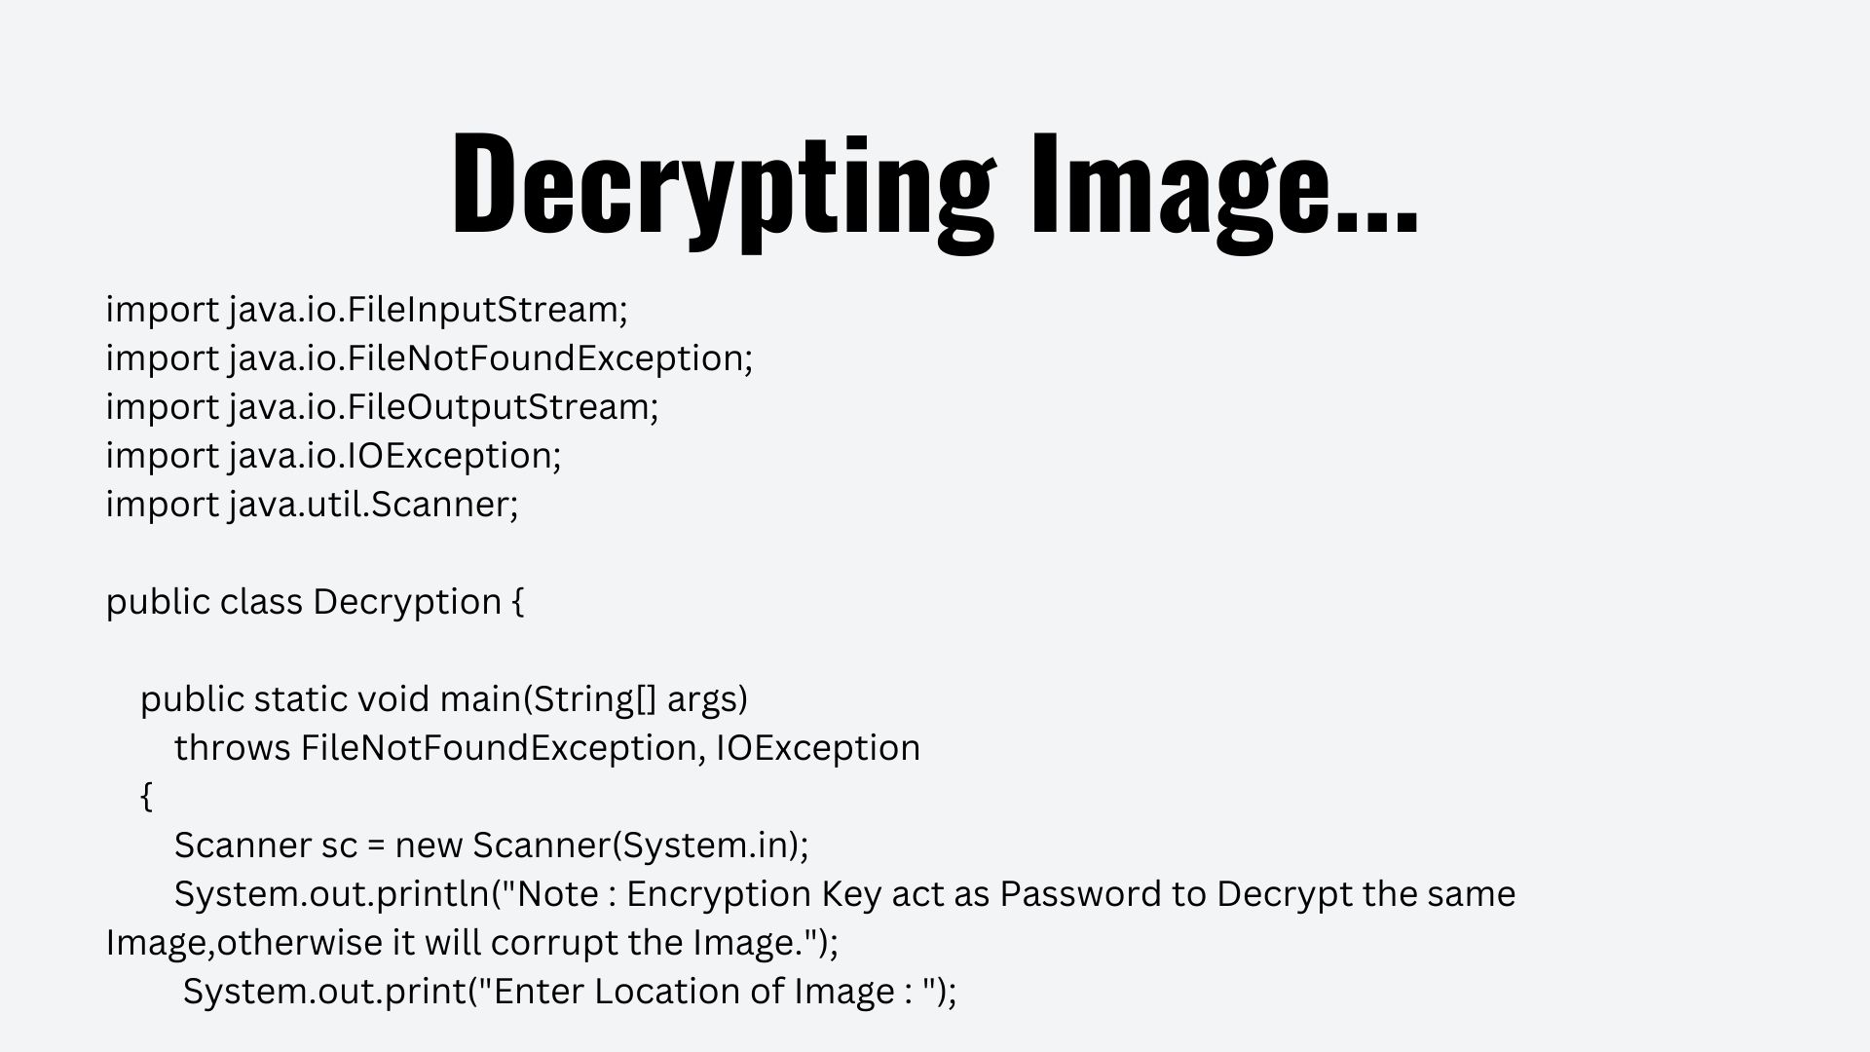

Slide 11
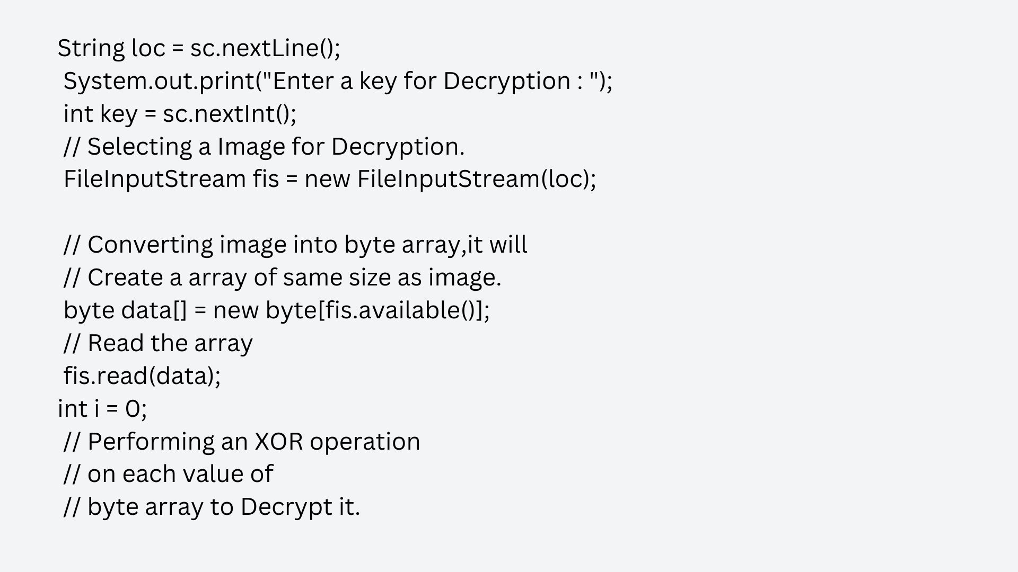

Slide 12
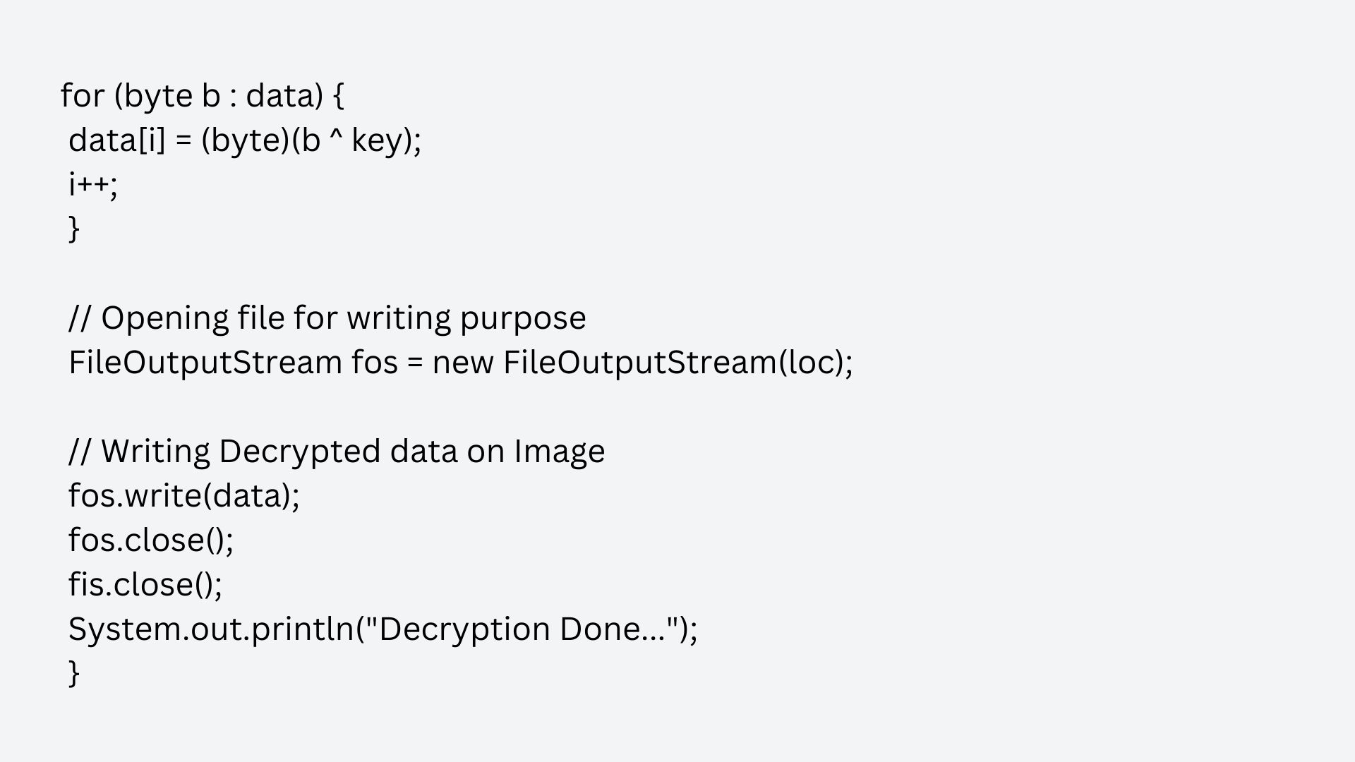

Slide 13
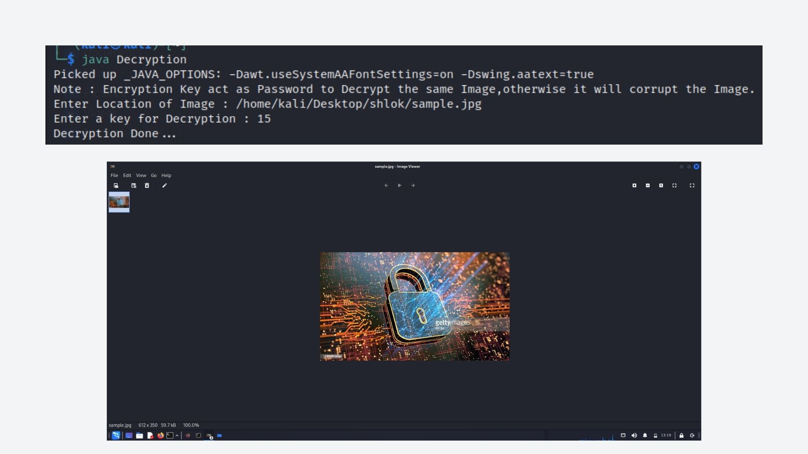

Slide 14


